Slide 1
Examining the Sensitivity of Sewage Network Surveillance Sampling Plans using Simulation Models
Concept Presentation
Wolfgang & Andrew
Notes:
Wolfgang Mairinger

Slide 2
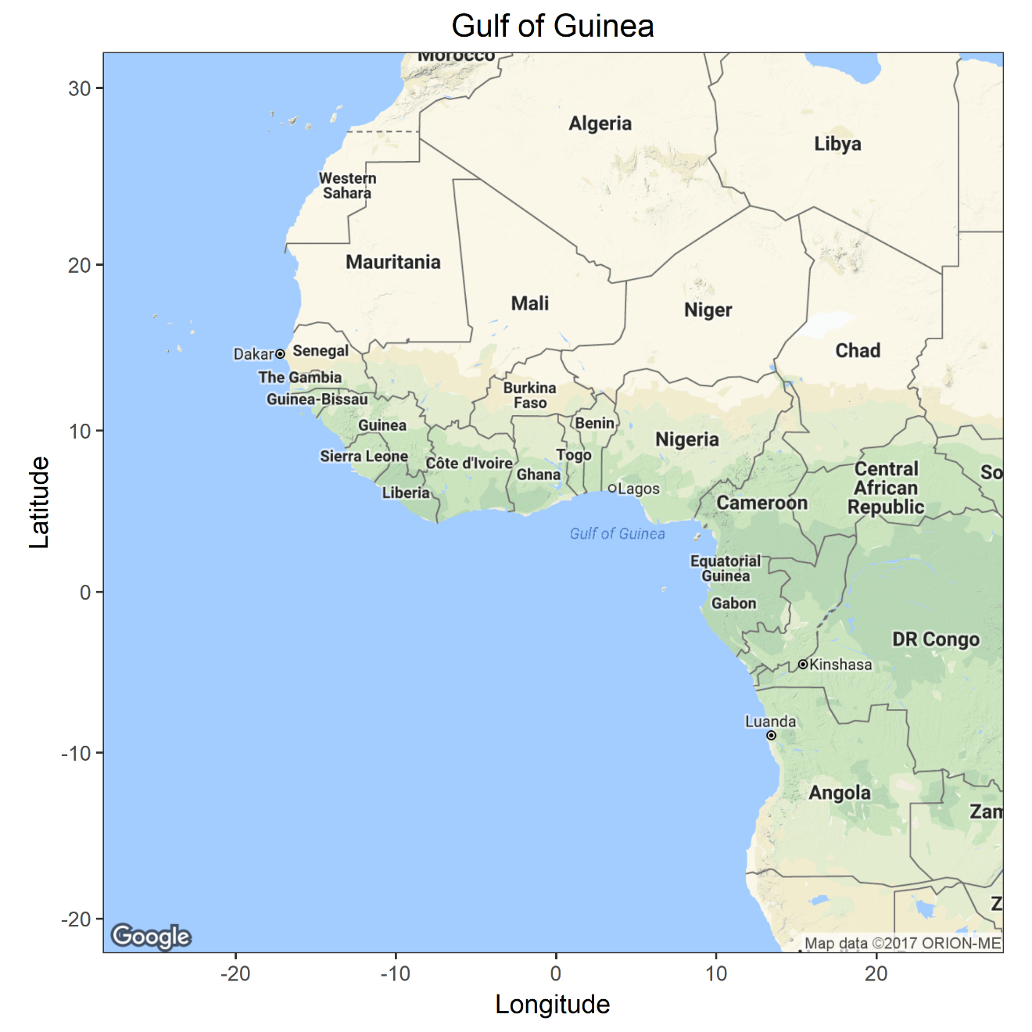
West Africa

Slide 3
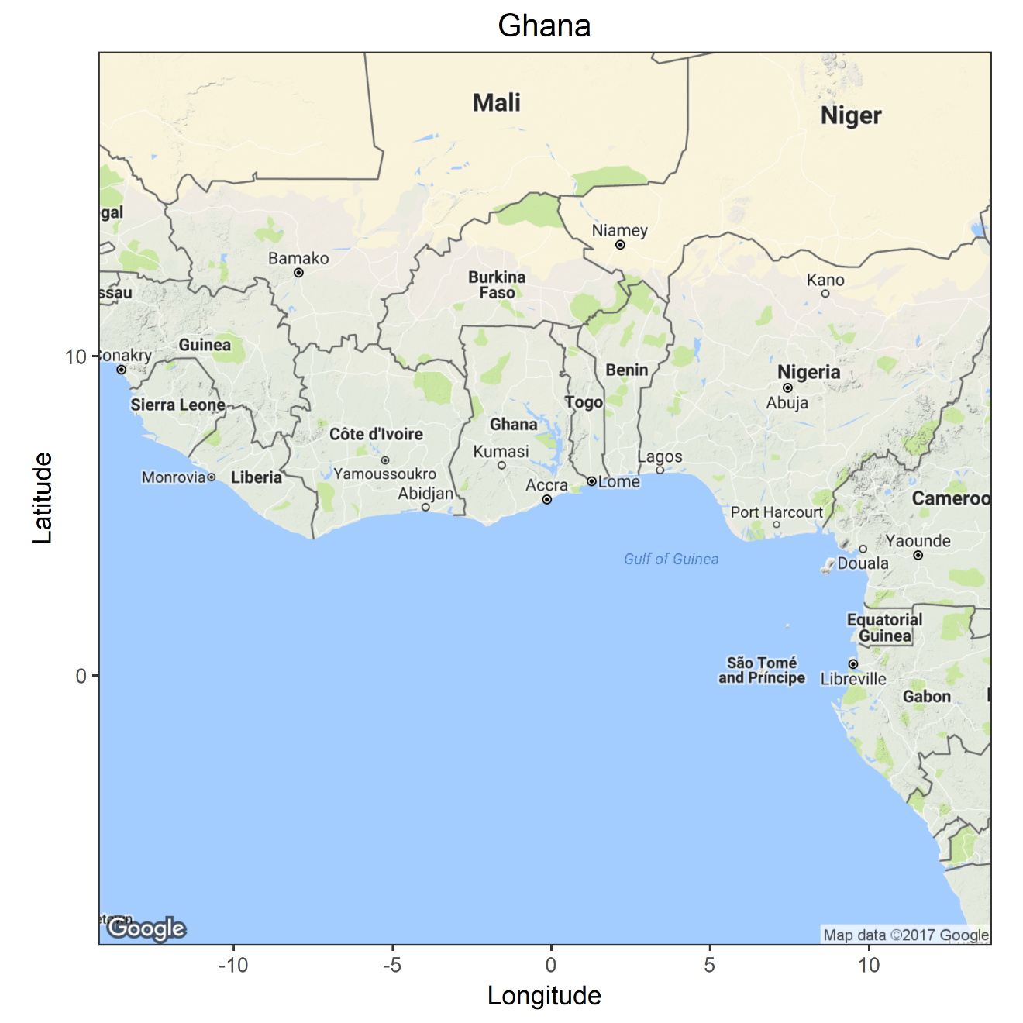
Ghana

Slide 4
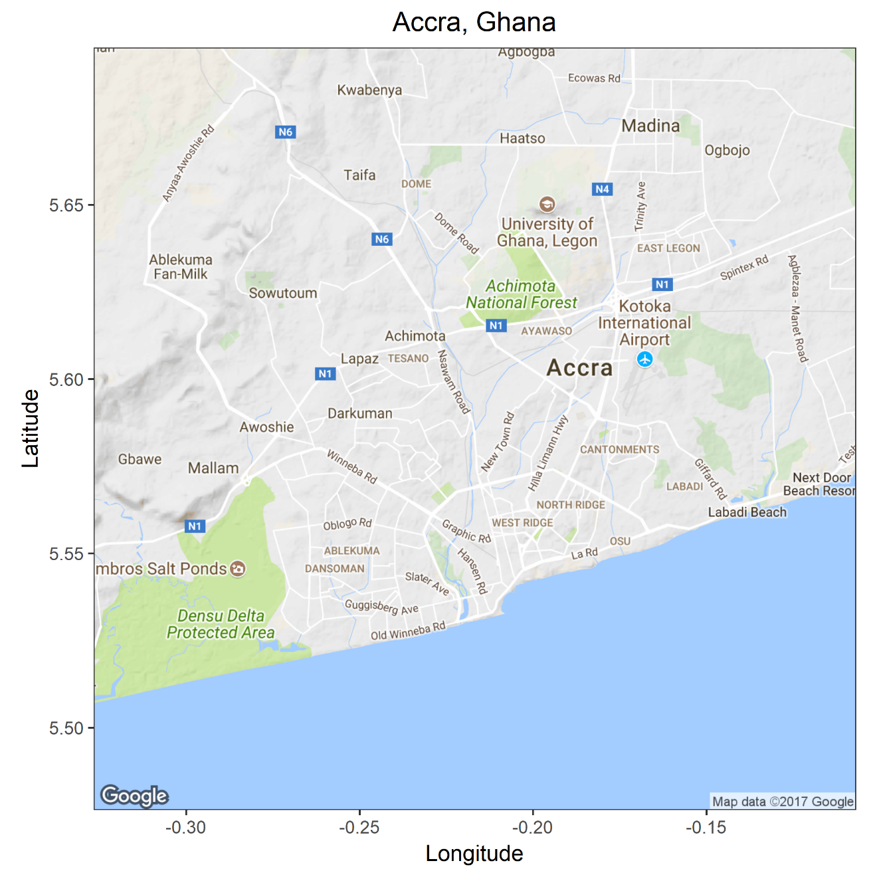
Accra, Ghana
Greater Accra Area:
Population: 4.6 Mio
Accra:
Population: 1.7 Mio
Households: 481,000
People per Household: 3.8
Area: 132 km²
Population Density: 12,583 people /km²
Liquid waste disposal into sewage 11%
Source: Ghana Statistical Service

Slide 5
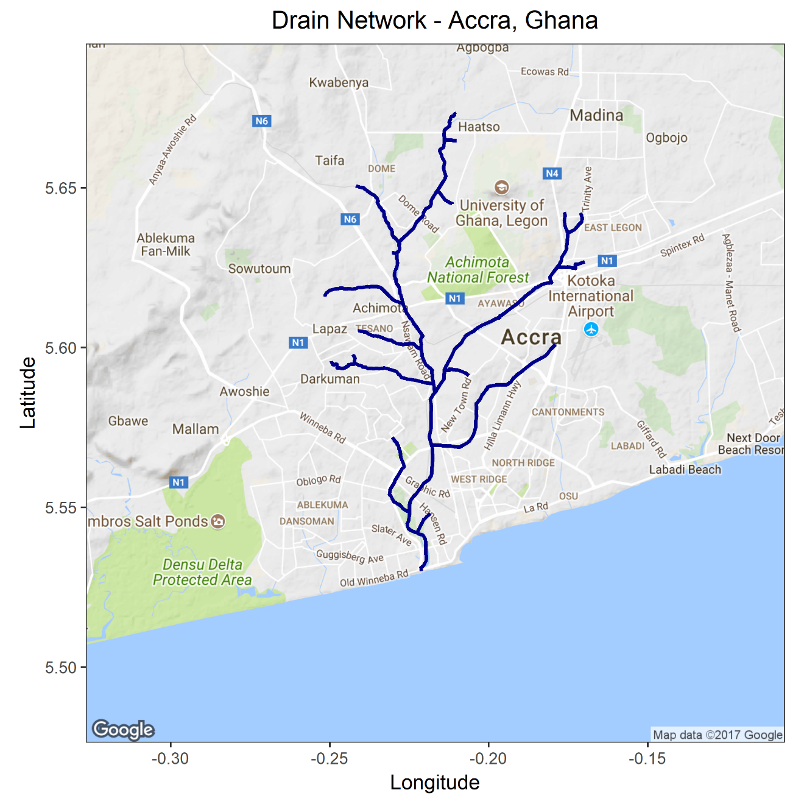
Drain Network
One main drain was selected that covers most of the neighborhoods in the city.

Slide 6
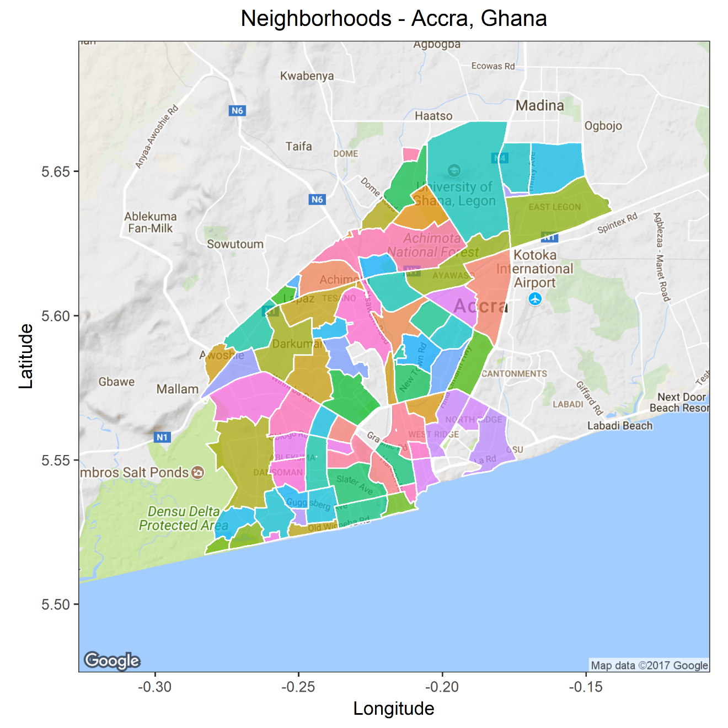
Neighborhoods

Slide 7
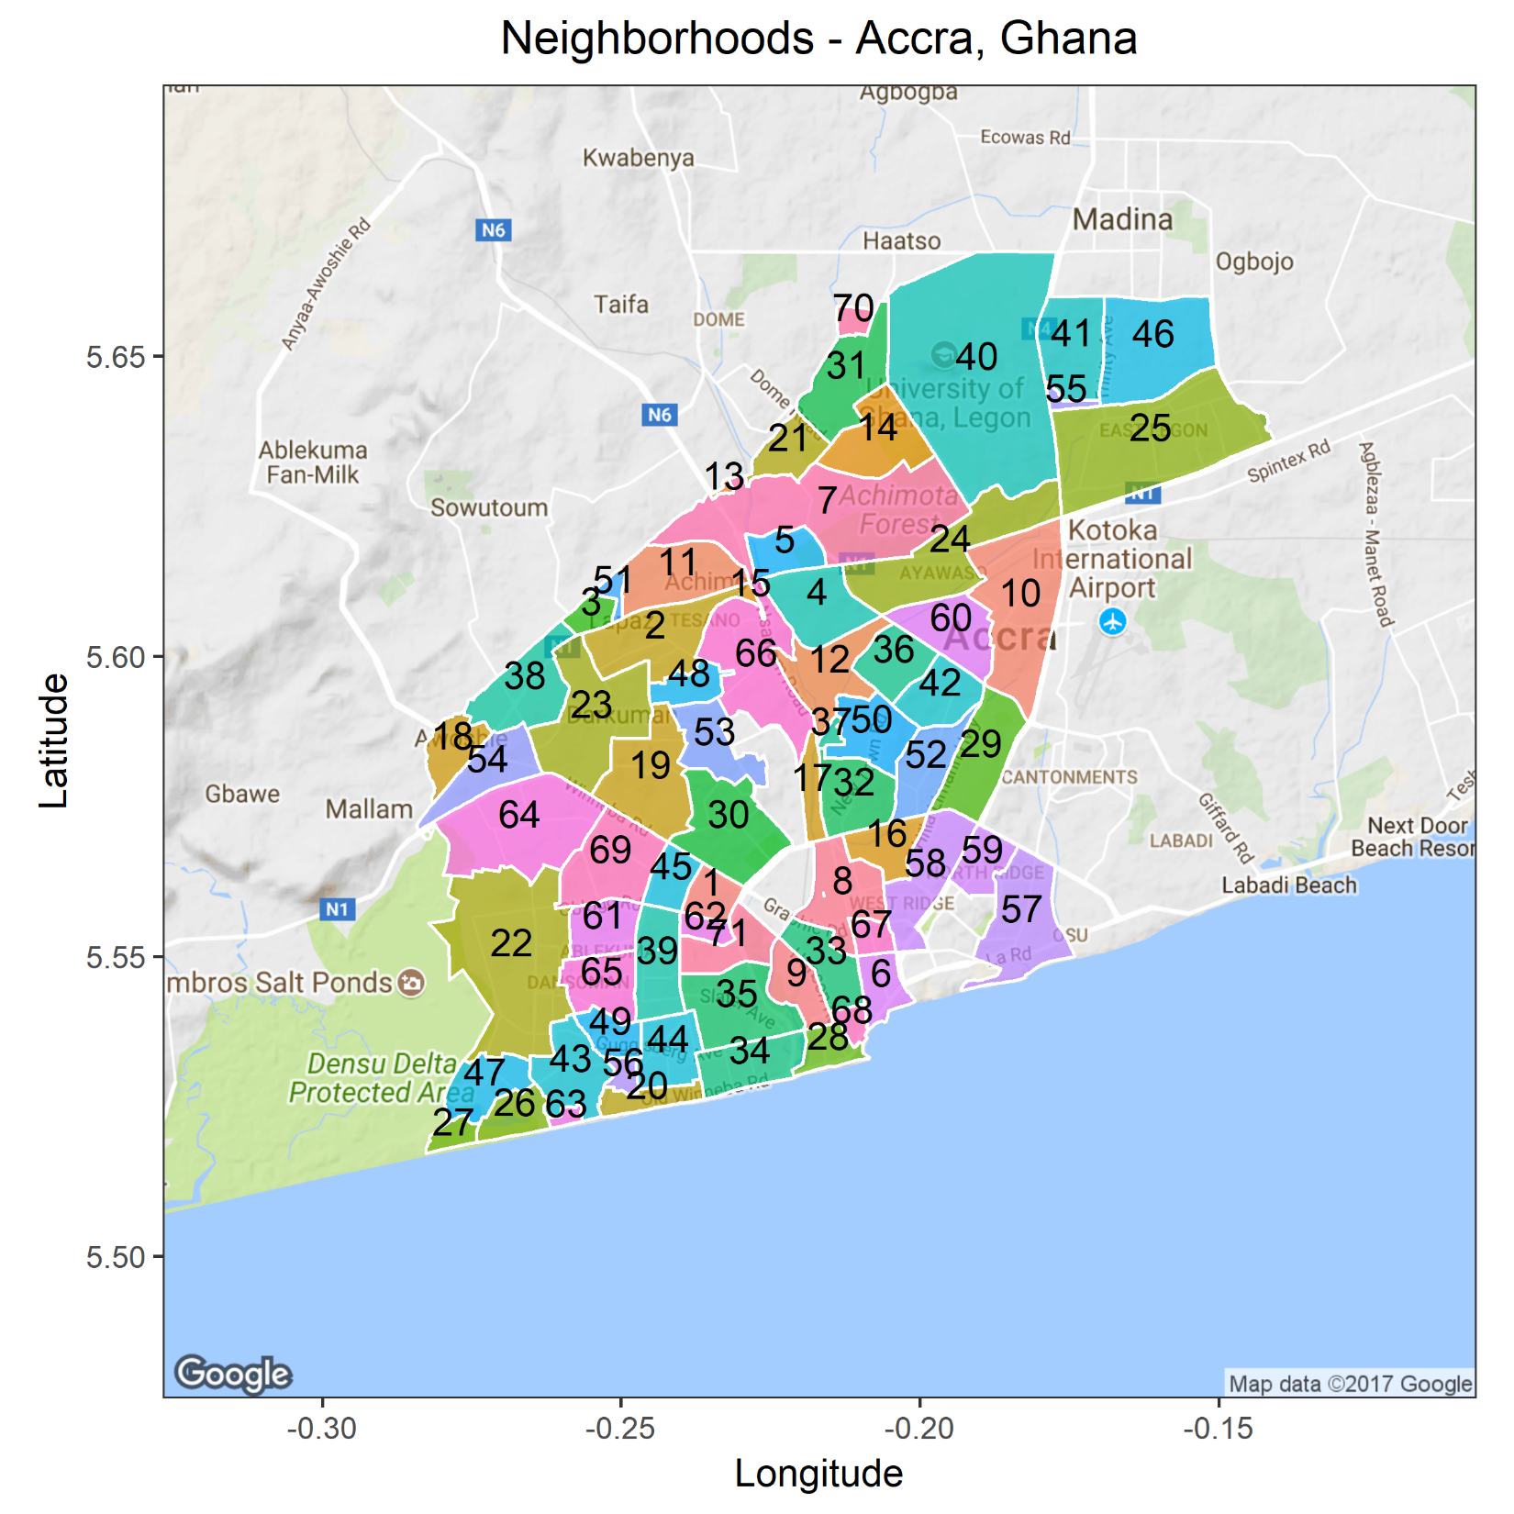
Neighborhoods
71 Neighborhoods

Slide 8
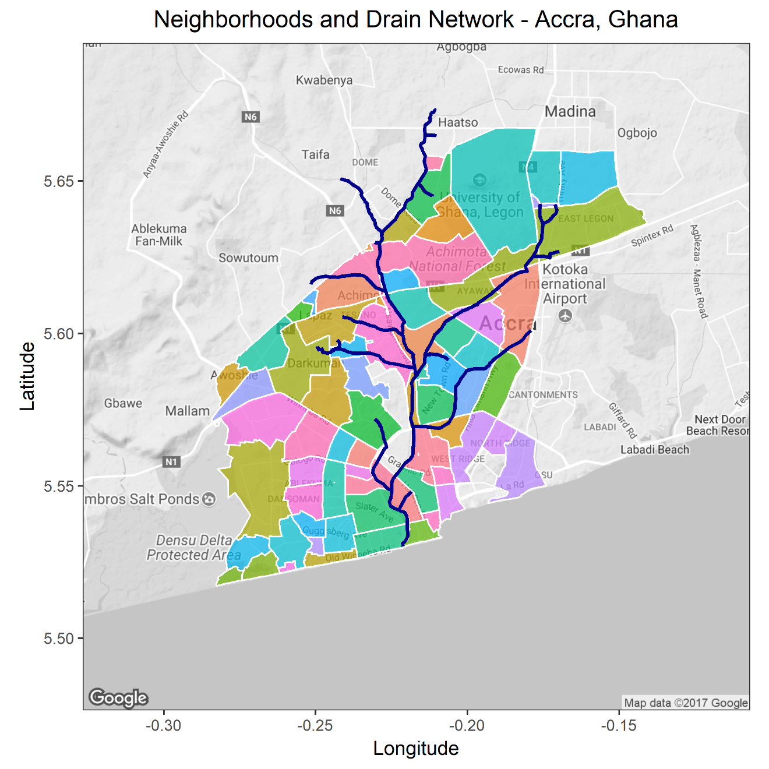
Neighborhoods and Drain Network

Slide 9
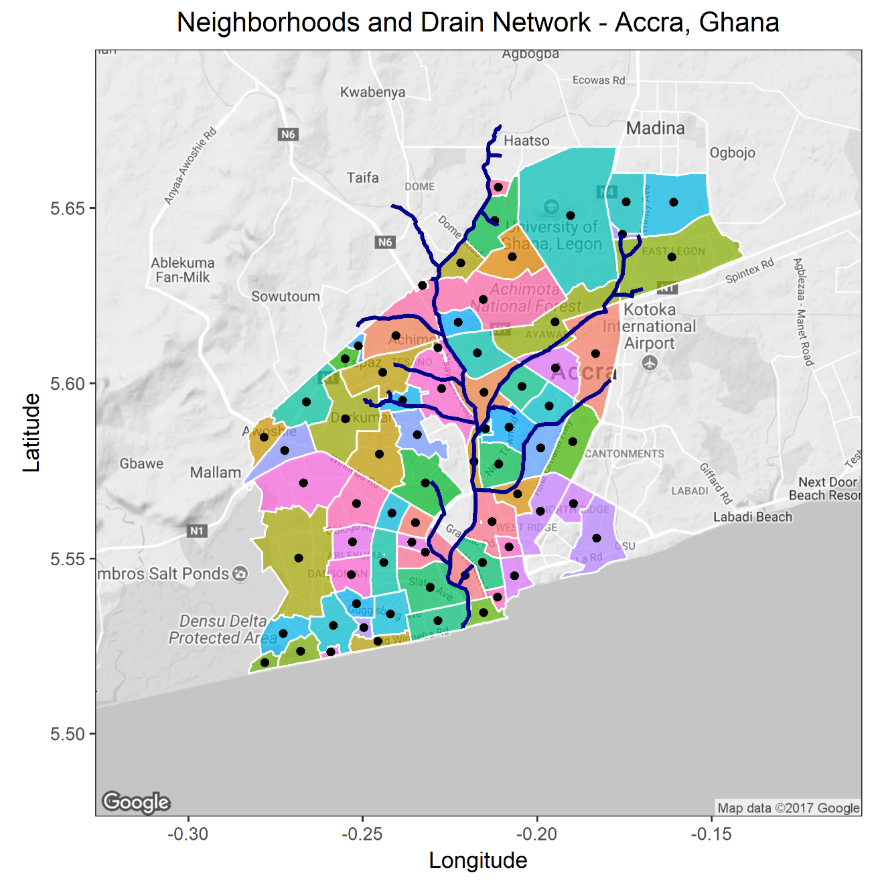
Weighted Mean Center of Neighborhoods
Neighborhood point
Shortest distance to drain

Slide 10
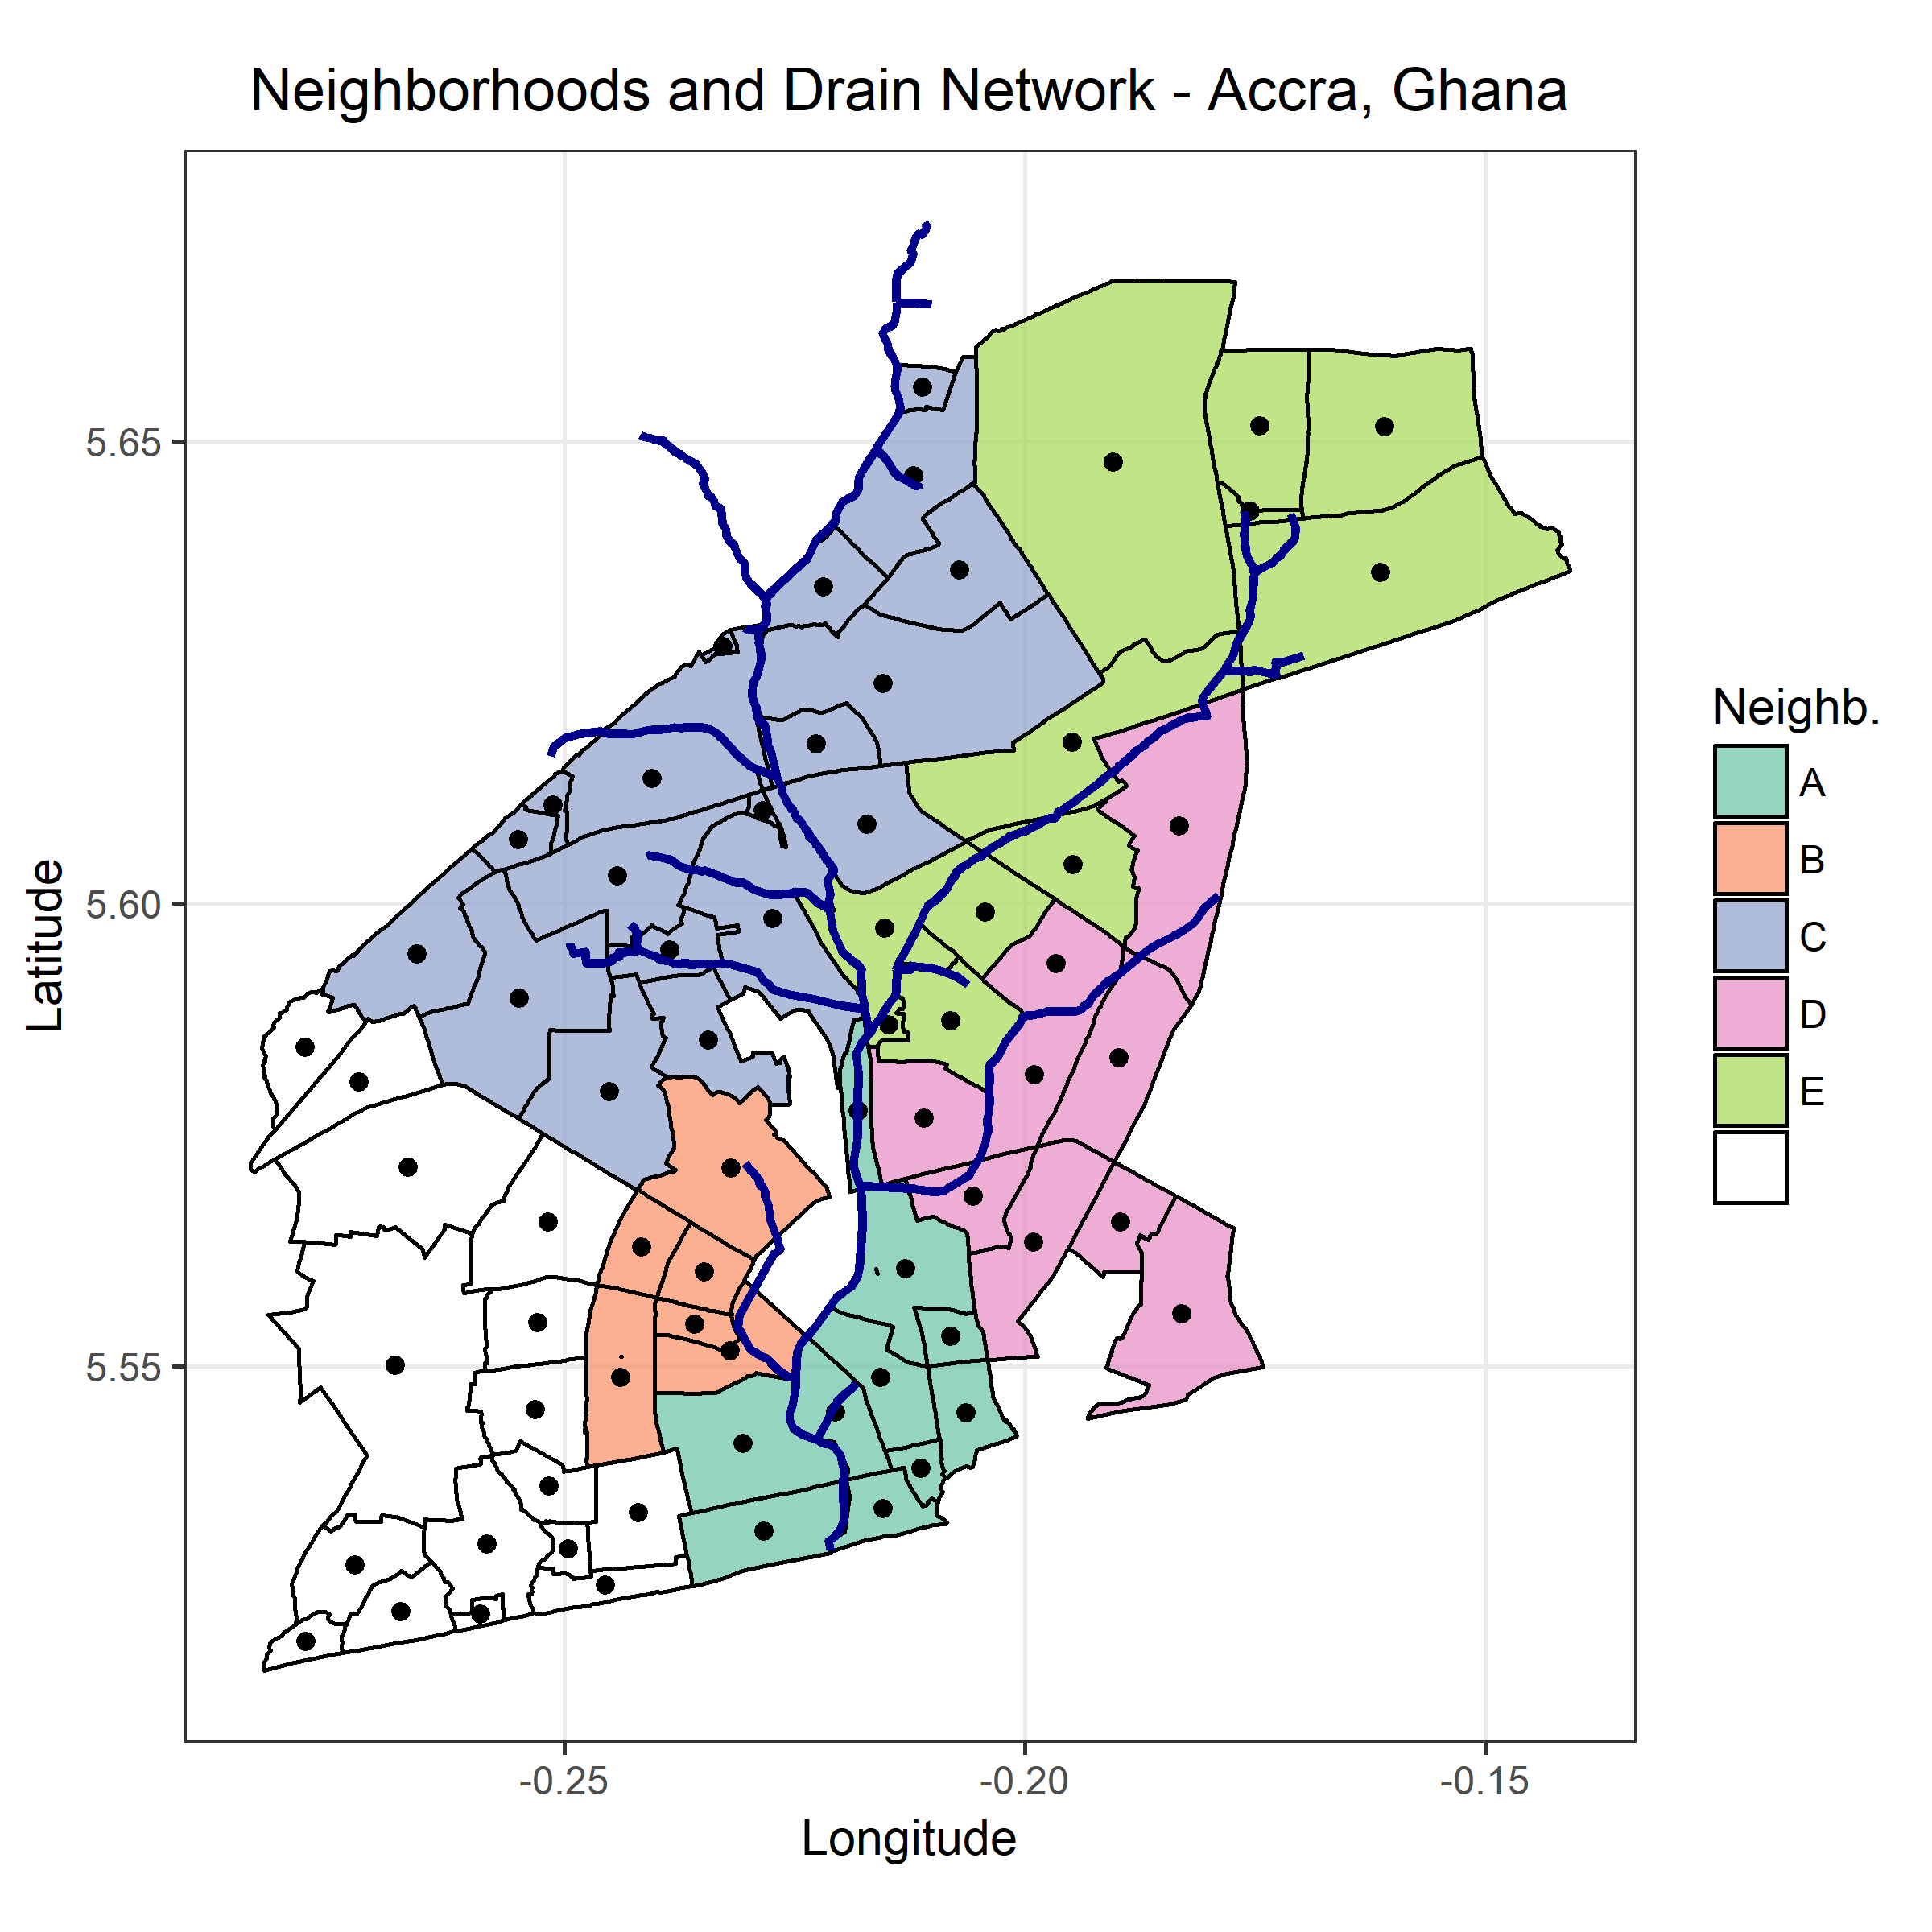
Classification of Neighborhoods

Slide 11
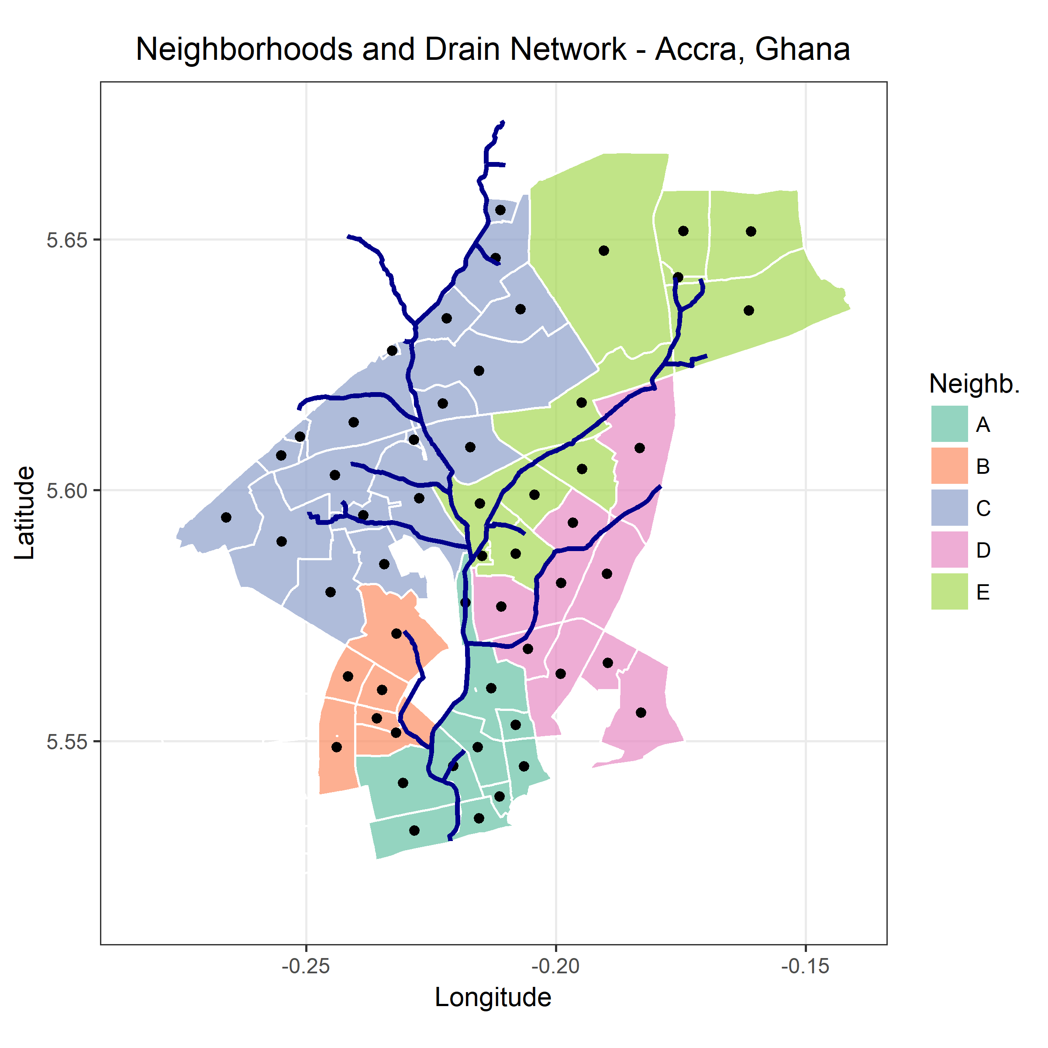
Weighted Mean Center of Neighborhoods

Slide 12

Neighborhoods and Drain Network
Final map

Slide 13
Surveillance Stations
C
E
D
B
A

Slide 14
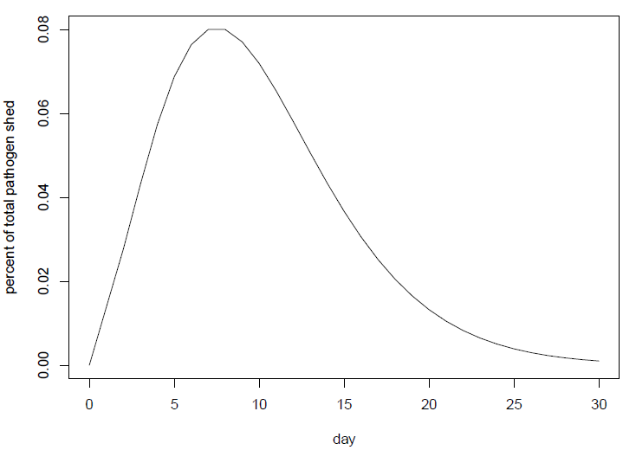
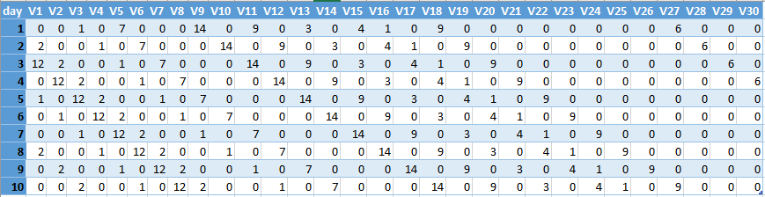
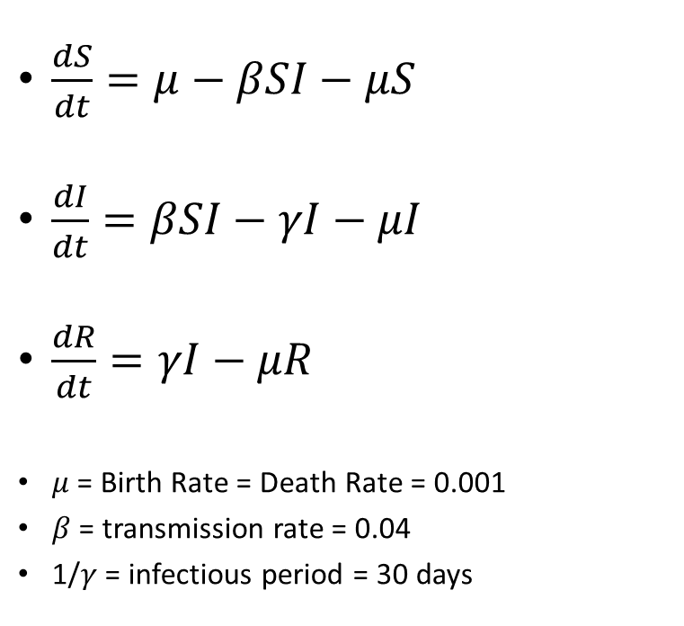
SIR Model
$\frac{dS}{dt}=μ−βSI−μS$
$\frac{dI}{dt}=βSI−γI−μI$
$\frac{dR}{dt}=γI−μR$
$μ$ = Birth Rate = Death Rate = 0.001
$β$ = transmission rate = 0.04
1/$γ$ = infectious period = 30 days

Slide 15
Pathogen Journey
C
E
D
B
A

Slide 16
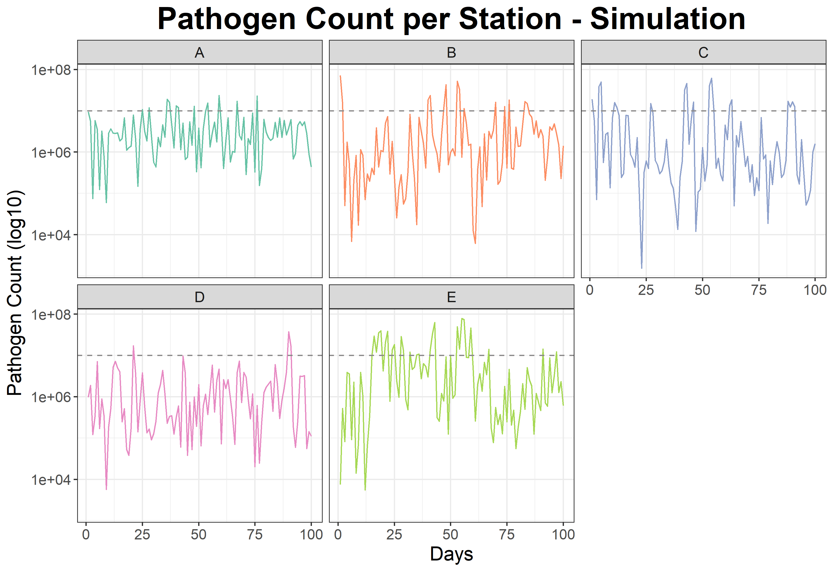
Positive sample: limit = 10^7

Slide 17
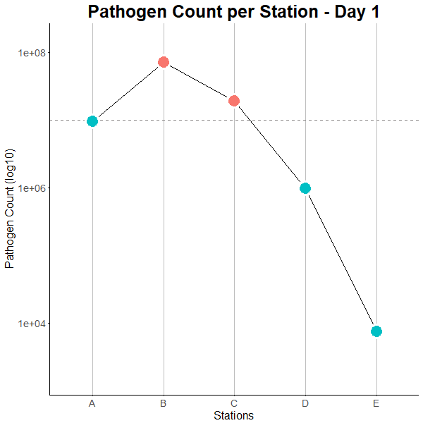
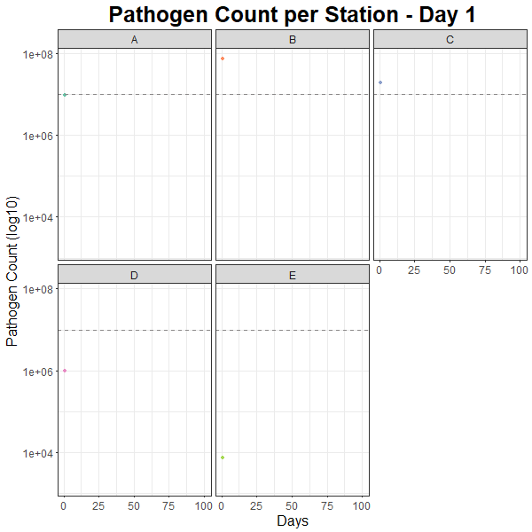
Simulation
C
E
D
B
Positive sample: limit = 10^7
A
Notes:
Animation: 2 frames per second (R setting .5)

Slide 18
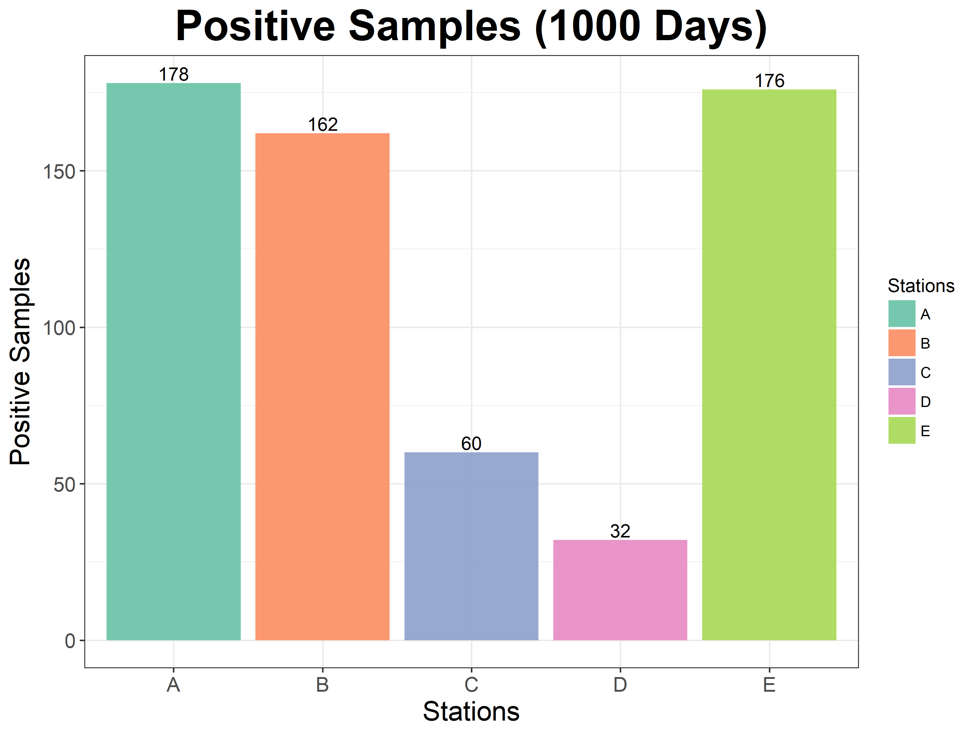
Positive sample: limit = 10^7

Slide 19
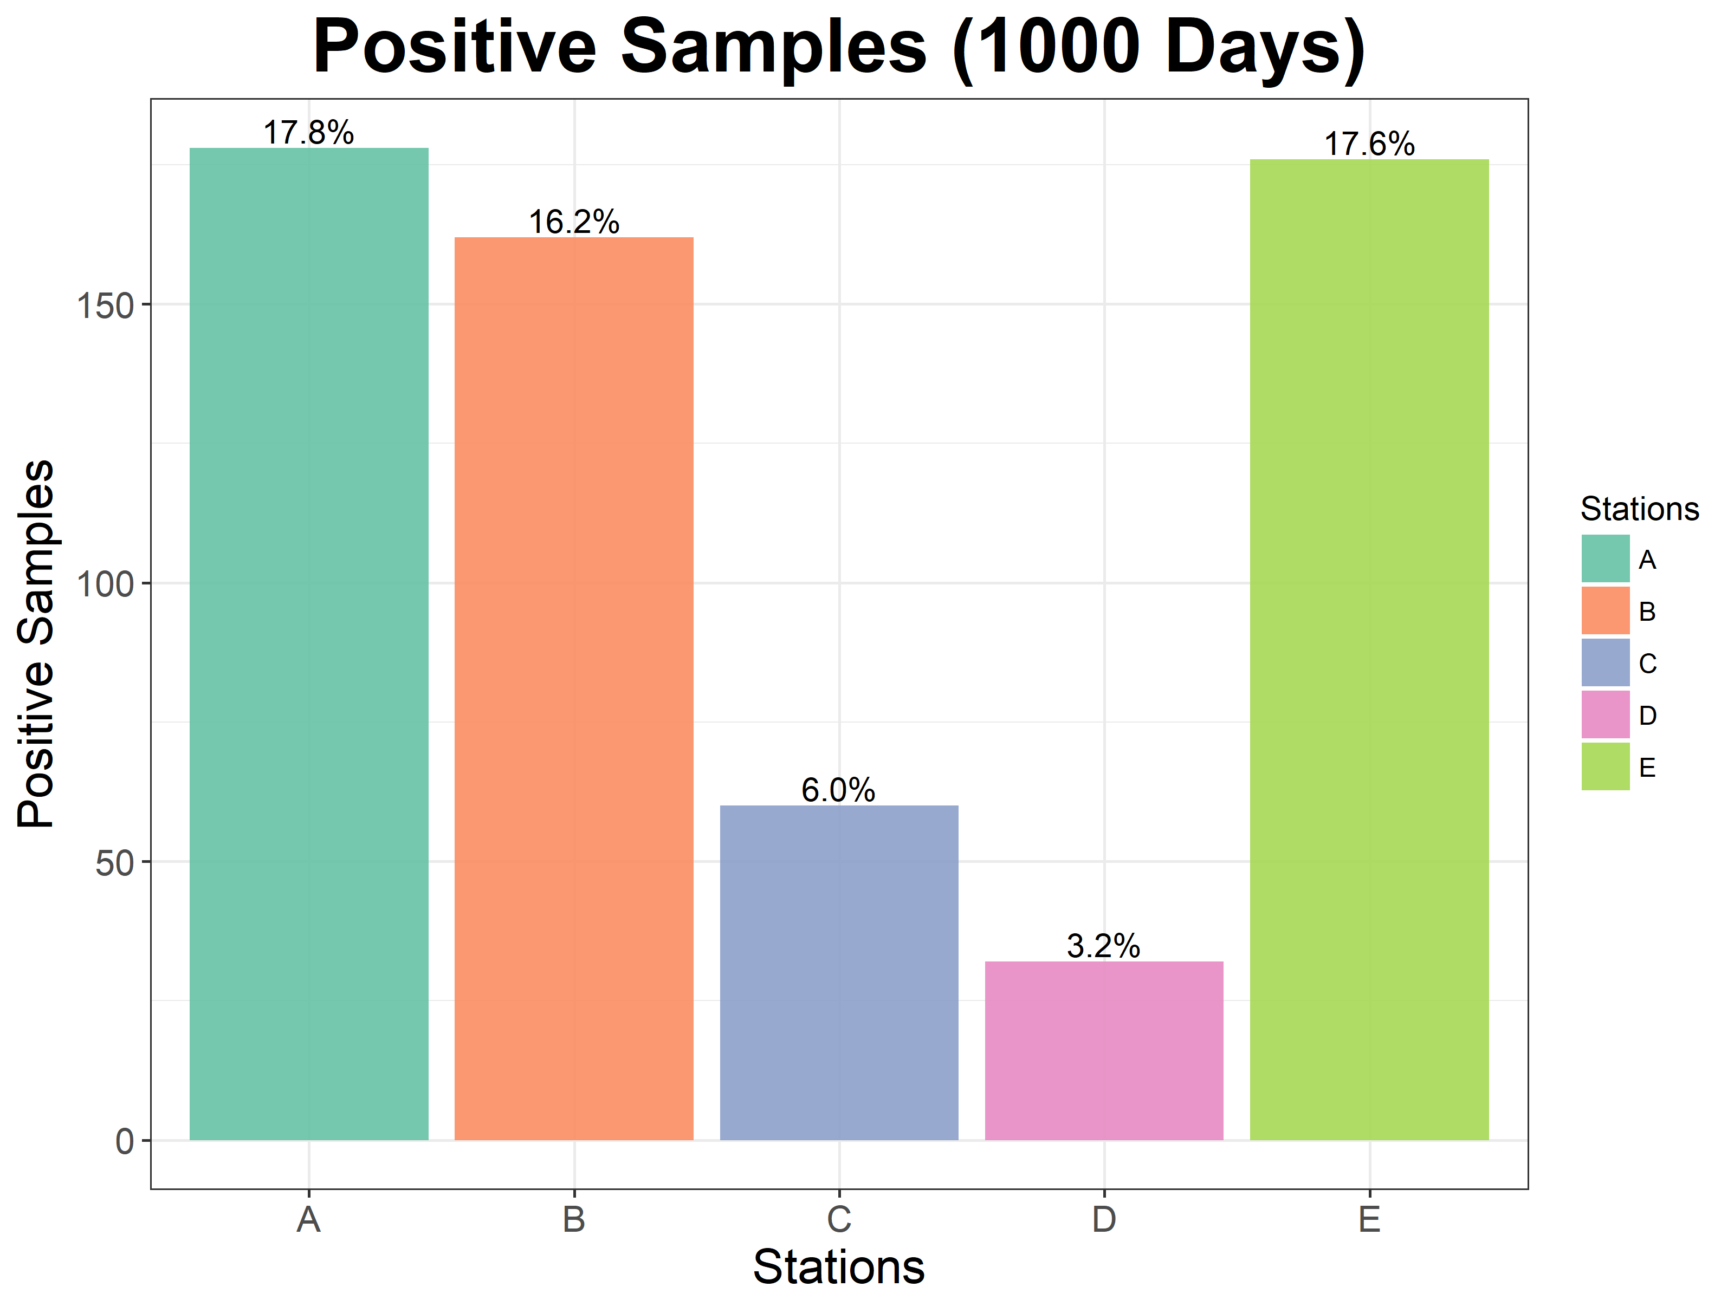
Positive sample: limit = 10^7

Slide 20
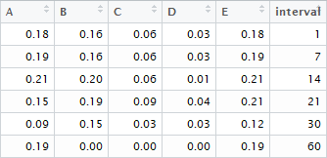
Sampling Intervals
i.e.: If a sample is taken every 14 days (in the 1000 days timespan), 21% of the samples taken at station A would be positive.
Positive sample: limit = 10^7

Slide 21
Future Steps
Ability to select specific neighborhoods for outbreak
Holding everything else constant
Evaluate various scenarios
Application of different models
Add distinguishable drain levels
Different flow speed for main, secondary, and tertiary drains
Develop model/ script further to apply to other study sites

Slide 22
Extra Slides

Slide 23
Calculations – Drain Length
Neighborhood to drain
Drain to endpoint

Slide 24
Inputs
Graphics
Drain network
Neighborhoods
Data
Population
% liquid waste sewage disposal

Slide 25
Black box
Distance/ time drain
Neighborhood to drain
SIR model
Pathogen count decline
Positive case matrix

Slide 26
Outputs
Maps
Pathogen counts
Case counts
Sampling intervals

